Slide 1
Virtual memory
Peyman Pahlevani

Slide 2
Memory Virtualizing with Efficiency and Control
Memory virtualizing takes a similar strategy known as limited direct execution(LDE) for efficiency and control.
In memory virtualizing, efficiency and control are attained by hardware support.
e.g., registers, TLB(Translation Look-aside Buffer)s, page-table

Slide 3
Address Translation
Hardware transforms a virtual address to a physical address.
The desired information is actually stored in a physical address.
The OS must get involved at key points to set up the hardware.
The OS must manage memory to judiciously intervene.

Slide 4
Example: Address Translation
C - Language code
Load a value from memory
Increment it by three
Store the value back into memory
void func()
int x;
...
x = x + 3; // this is the line of code we are interested in

Slide 5
Example: Address Translation(Cont.)
Assembly
Presume that the address of ‘x’ has been place in ebx register.
Load the value at that address into eax register.
Add 3 to eax register.
Store the value in eax back into memory.
128 : movl 0x0(%ebx), %eax ; load 0+ebx into eax
132 : addl $0x03, %eax ; add 3 to eax register
135 : movl %eax, 0x0(%ebx) ; store eax back to mem

Slide 6
Example: Address Translation(Cont.)
0KB
128
132
135
Fetch instruction at address 128
Execute this instruction (load from address 15KB)
Fetch instruction at address 132
Execute this instruction (no memory reference)
Fetch the instruction at address 135
Execute this instruction (store to address 15 KB)
movl 0x0(%ebx),%eax
Addl 0x03,%eax
movl %eax,0x0(%ebx)
Program Code
1KB
2KB
Heap
3KB
4KB
(free)
heap
stack
14KB
3000
Stack
15KB
16KB

Slide 7
Relocation Address Space
The OS wants to place the process somewhere else in physical memory, not at address 0.
The address space start at address 0.

Slide 8
A Single Relocated Process
0KB
0KB
Program Code
Operating System
Heap
16KB
(not in use)
(free)
32KB
Relocated Process
Code
Heap
heap
(allocated but not in use)
stack
48KB
Stack
(not in use)
Stack
64KB
16KB
Physical Memory
Address Space

Slide 9
Base and Bounds Register
0KB
0KB
Program Code
Operating System
Heap
16KB
(not in use)
base register
(free)
32KB
32KB
Code
Heap
heap
(allocated but not in use)
stack
48KB
Stack
(not in use)
Stack
bounds register
64KB
16KB
Physical Memory
16KB
Address Space

Slide 10
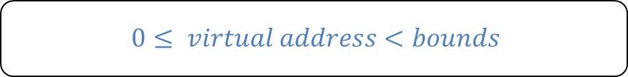
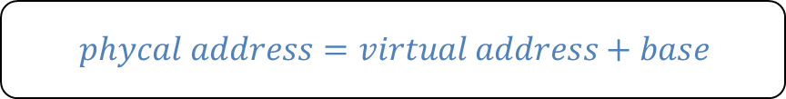
Dynamic (Hardware base) Relocation
When a program starts running, the OS decides where in physical memory a process should be loaded.
Set the base register a value.
Every virtual address must not be greater than bound and negative.
$$phycal address=virtual address+base$$
$$0≤ virtual address<bounds$$

Slide 11


Relocation and Address Translation
Fetch instruction at address 128
Execute this instruction
Load from address 15KB
128 : movl 0x0(%ebx), %eax
0KB
128
132
135
movl 0x0(%ebx),%eax
Addl 0x03,%eax
movl %eax,0x0(%ebx)
Program Code
1KB
2KB
Heap
$$32896=128+32KB(base)$$
3KB
4KB
(free)
heap
$$47KB=15KB+32KB(base)$$
stack
14KB
3000
Stack
15KB
16KB

Slide 12


Two ways of Bounds Register
0KB
0KB
Program Code
Operating System
Heap
16KB
(not in use)
(free)
32KB
Code
$$physical address of$$
$$the end of$$
$address space$
$$the size of$$
$$address spacee$$
Heap
(allocated but not in use)
bounds
bounds
16KB
48KB
Stack
48KB
(not in use)
Stack
64KB
Physical Memory
16KB
Address Space

Slide 13
OS Issues for Memory Virtualizing
The OS must take action to implement base-and-bounds approach.
Three critical junctures:
When a process starts running:
Finding space for address space in physical memory
When a process is terminated:
Reclaiming the memory for use
When context switch occurs:
Saving and storing the base-and-bounds pair

Slide 14
OS Issues: When a Process Starts Running
The OS must find a room for a new address space.
free list : A list of the range of the physical memory which are not in use.
0KB
Operating System
The OS lookup the free list
Free list
16KB
(not in use)
16KB
32KB
Code
Heap
(allocated but not in use)
48KB
48KB
Stack
(not in use)
64KB
Physical Memory

Slide 15
OS Issues: When a Process Is Terminated
The OS must put the memory back on the free list.
Free list
0KB
Operating System
Free list
0KB
Operating System
16KB
16KB
16KB
16KB
(not in use)
(not in use)
32KB
32KB
Process A
32KB
(not in use)
48KB
48KB
48KB
(not in use)
(not in use)
48KB
64KB
64KB
Physical Memory
Physical Memory

Slide 16
OS Issues: When Context Switch Occurs
The OS must save and restore the base-and-bounds pair.
In process structure or process control block(PCB)
Process A PCB
…
base : 32KB
bounds : 48KB …
0KB
Operating System
0KB
Operating System
Context Switching
16KB
(not in use)
16KB
(not in use)
base
base
32KB
32KB
32KB
48KB
Process A
Currently Running
Process A
bounds
bounds
48KB
48KB
48KB
64KB
Process B
Process B
Currently Running
64KB
64KB
Physical Memory
Physical Memory

Slide 17
What are the challenges of the pervious approach?
Large process
Small process

Slide 18
Paging

Slide 19
Concept of Paging
Paging splits up address space into fixed-zed unit called a page.
Segmentation: variable size of logical segments (code, stack, heap, etc.)
With paging, physical memory is also split into some number of pages called a page frame.
Page table per process is needed to translate the virtual address to physical address.

Slide 20
Advantages Of Paging
Small Process
Large process

Slide 21
Example: A Simple Paging
128-byte physical memory with 16 bytes page frames
64-byte address space with 16 bytes pages
0
page frame 0 of physical memory
reserved for OS
16
0
(unused)
page frame 1
(page 0 of the address space)
16
32
page 3 of AS
page frame 2
(page 1)
32
48
(page 2)
page 0 of AS
page frame 3
48
64
(page 3)
(unused)
page frame 4
64
80
A Simple 64-byte Address Space
page 2 of AS
page frame 5
96
(unused)
page frame 6
112
page 1 of AS
page frame 7
128
64-Byte Address Space Placed In Physical Memory

Slide 22
Address Translation
Two components in the virtual address
VPN: virtual page number
Offset: offset within the page
Example: virtual address 21 in 64-byte address space
VPN
offset
Va5
Va4
Va3
Va2
Va1
Va0
VPN
offset
0
1
0
1
0
1

Slide 23
Example: Address Translation
The virtual address 21 in 64-byte address space
VPN
offset
Virtual
Address
0
1
0
1
0
1
Address Translation
Physical
Address
1
1
1
0
1
0
1
PFN
offset

Slide 24

Where Are Page Tables Stored?
Page tables can get awfully large
32-bit address space with 4-KB pages, 20 bits for VPN
${4MB= 2}^{20} entries ∗4 Bytes per page table entry$
Page tables for each process are stored in memory.

Slide 25
Example: Page Table in Kernel Physical Memory
0
page table
3 7 5 2
page frame 0 of physical memory
16
(unused)
page frame 1
32
page 3 of AS
page frame 2
48
page 0 of AS
page frame 3
64
(unused)
page frame 4
80
page 2 of AS
page frame 5
96
(unused)
page frame 6
112
page 1 of AS
page frame 7
128
Physical Memory

Slide 26
What Is In The Page Table?
The page table is just a data structure that is used to map the virtual address to physical address.
Simplest form: a linear page table, an array
The OS indexes the array by VPN, and looks up the page-table entry.

Slide 27
Common Flags Of Page Table Entry
Valid Bit: Indicating whether the particular translation is valid.
Protection Bit: Indicating whether the page could be read from, written to, or executed from
Present Bit: Indicating whether this page is in physical memory or on disk(swapped out)
Dirty Bit: Indicating whether the page has been modified since it was brought into memory
Reference Bit(Accessed Bit): Indicating that a page has been accessed

Slide 28
Example: x86 Page Table Entry
31 | 30 | 29 | 28 | 27 | 26 | 25 | 24 | 23 | 22 | 21 | 20 | 19 | 18 | 17 | 16 | 15 | 14 | 13 | 12 | 11 | 10 | 9 | 8 | 7 | 6 | 5 | 4 | 3 | 2 | 1 | 0
PFN
G
PAT
D
A
PCD
PWT
U/S
R/W
P
P: present
R/W: read/write bit
U/S: supervisor
A: accessed bit
D: dirty bit
PFN: the page frame number
An x86 Page Table Entry(PTE)

Slide 29
Paging: Too Slow
To find a location of the desired PTE, the starting location of the page table is needed.
For every memory reference, paging requires the OS to perform one extra memory reference.

Slide 30
Translation Lookaside Buffers

Slide 31
TLB
Part of the chip’s memory-management unit(MMU).
A hardware cache of popular virtual-to-physical address translation.
TLB
Lookup
MMU
Logical
Address
TLB Hit
Physical
Address
TLB
popular v to p
TLB Miss
CPU
Page Table
all v to p entries
Page 0
Page 1
Page 2
…
Page n
Address Translation with MMU
Physical Memory

Slide 32
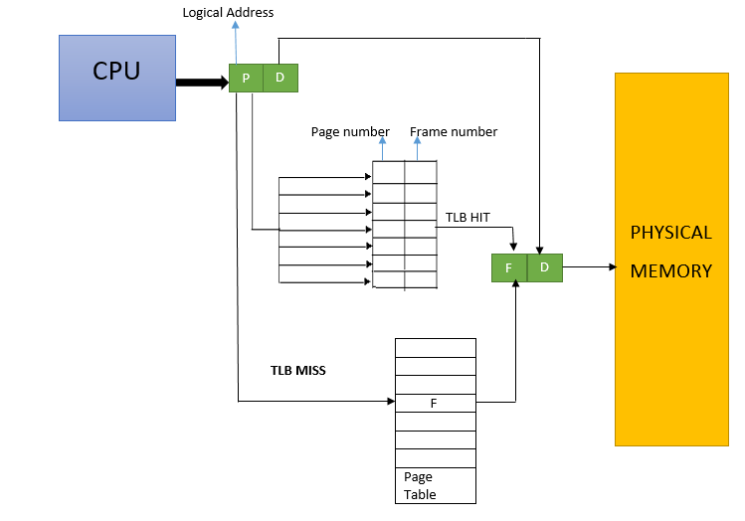
TLB

Slide 33
Example: Accessing An Array
How a TLB can improve its performance.
OFFSET 00 04 08 12 16
VPN = 00
VPN = 01
VPN = 03
VPN = 04
VPN = 05
VPN = 06 |  | a[0] | a[1] | a[2]
VPN = 07 | a[3] | a[4] | a[5] | a[6]
VPN = 08 | a[7] | a[8] | a[9]
VPN = 09
VPN = 10
VPN = 11
VPN = 12
VPN = 13
VPN = 14
VPN = 15
0: int sum = 0 ;
1: for( i=0; i<10; i++){
2: sum+=a[i];
3: }
The TLB improves performance
due to spatial locality
Thus TLB 3 misses and 7 hits.
it rate is 70%.

Slide 34
Locality
Temporal Locality
An instruction or data item that has been recently accessed will likely be re-accessed soon in the future.
Spatial Locality
If a program accesses memory at address x, it will likely soon access memory near x.
1st access is page1.
2nd access is also page1.
Page 6
…
Page 1
Page 7
Page 2
Page 3
Page 4
Page 5
Page n
Virtual Memory
1st access is page1.
2nd access is near by page1.
Page 1
Page 2
Page 3
Page 4
Page 5
…
Page n
Virtual Memory

Slide 35
Who Handles The TLB Miss?
Hardware handle the TLB miss entirely on CISC.
The hardware has to know exactly where the page tables are located in memory.
The hardware would “walk” the page table, find the correct page-table entry and extract the desired translation, update and retry instruction.
hardware-managed TLB.

Slide 36
Who Handles The TLB Miss? (Cont.)
RISC have what is known as a software-managed TLB.
On a TLB miss, the hardware raises exception( trap handler ).
Trap handler is code within the OS that is written with the express purpose of handling TLB miss.

Slide 37
TLB Control Flow algorithm(OS Handled)
1: VPN = (VirtualAddress & VPN_MASK) >> SHIFT
2: (Success, TlbEntry) = TLB_Lookup(VPN)
3: if (Success == True) // TLB Hit
4: if (CanAccess(TlbEntry.ProtectBits) == True)
5: Offset = VirtualAddress & OFFSET_MASK
6: PhysAddr = (TlbEntry.PFN << SHIFT) | Offset
7: Register = AccessMemory(PhysAddr)
8: else
9: RaiseException(PROTECTION_FAULT)
10: else // TLB Miss
11: RaiseException(TLB_MISS)

Slide 38
TLB entry
A typical TLB might have 32,64, or 128 entries.
Hardware search the entire TLB in parallel to find the desired translation.
other bits: valid bits , protection bits, address-space identifier, dirty bit
VPN
PFN
other bits
Typical TLB entry look like this

Slide 39
TLB Issue: Context Switching
Page 0
Page 1
Process A
Page 2
Insert TLB Entry
access VPN10
…
Page n
TLB Table
Virtual Memory
VPN | PFN | valid | prot
10 | 100 | 1 | rwx
- | - | - | -
- | - | - | -
- | - | - | -
Page 0
Process B
Page 1
Page 2
…
Page n
Virtual Memory

Slide 40
TLB Issue: Context Switching
Page 0
Page 1
Process A
Page 2
…
Page n
TLB Table
Virtual Memory
VPN | PFN | valid | prot
10 | 100 | 1 | rwx
- | - | - | -
10 | 170 | 1 | rwx
- | - | - | -
Context
Switching
Page 0
Process B
access VPN10
Page 1
Page 2
Insert TLB Entry
…
Page n
Virtual Memory

Slide 41
TLB Issue: Context Switching
Page 0
Page 1
Process A
Page 2
…
Page n
TLB Table
Virtual Memory
VPN | PFN | valid | prot
10 | 100 | 1 | rwx
- | - | - | -
10 | 170 | 1 | rwx
- | - | - | -
Page 0
Process B
Page 1
Page 2
…
Can’t Distinguish which entry is
meant for which process
Page n
Virtual Memory

Slide 42
To Solve Problem
Provide an address space identifier(ASID) field in the TLB.
Page 0
Page 1
Process A
Page 2
…
TLB Table
Page n
VPN | PFN | valid | prot | ASID
10 | 100 | 1 | rwx | 1
- | - | - | - | -
10 | 170 | 1 | rwx | 2
- | - | - | - | -
Virtual Memory
Page 0
Process B
Page 1
Page 2
…
Page n
Virtual Memory

Slide 43
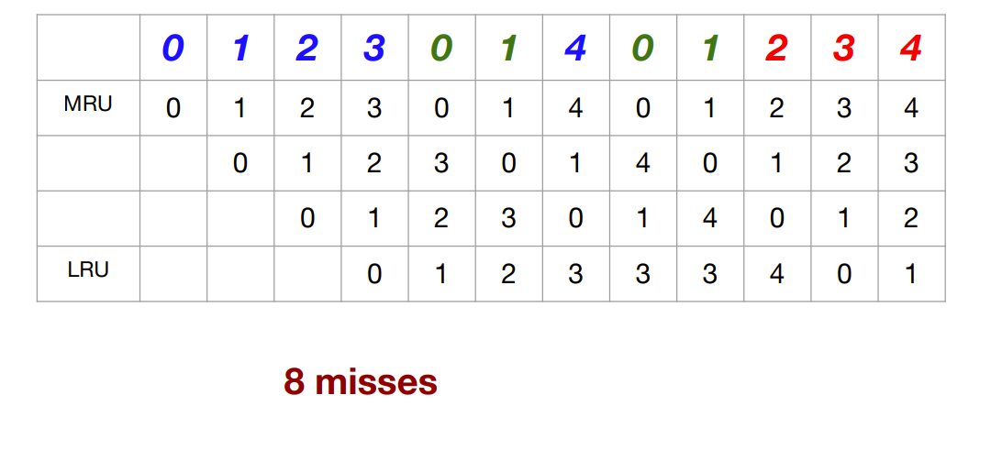
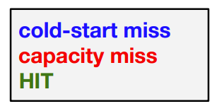
TLB Replacement Policy
LRU (Least Recently Used)
Evict an entry that has not recently been used.
Take advantage of locality in the memory-reference stream.
reference trace: 0, 1, 2, 3, 0, 1, 4, 0, 1, 2, 3, 4

Slide 44
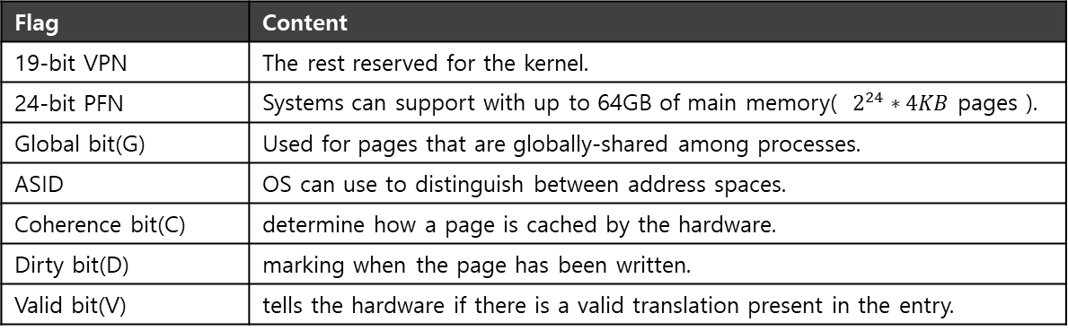
A Real TLB Entry
All 64 bits of this TLB entry(example of MIPS R4000)
0 1 2 3 4 5 6 7 8 9
10 11 … 19 … 31
VPN
G
ASID
PFN
C
D
V
Flag | Content
19-bit VPN | The rest reserved for the kernel.
24-bit PFN | Systems can support with up to 64GB of main memory( $2^{24}∗4KB$ pages ).
Global bit(G) | Used for pages that are globally-shared among processes.
ASID | OS can use to distinguish between address spaces.
Coherence bit(C) | determine how a page is cached by the hardware.
Dirty bit(D) | marking when the page has been written.
Valid bit(V) | tells the hardware if there is a valid translation present in the entry.

Slide 45
Question1:
Consider the page reference string
3, 8, 2, 3, 9, 1, 6, 3, 8, 9, 3, 6, 2, 1, 3
Find the number of page faults with LRU, where 5 page frames are present.

Slide 46
Question 2:
Consider a machine with 64 MB physical memory and a 32-bit virtual address space. If the page size is 4KB, what is the approximate size of the page table?

Slide 47
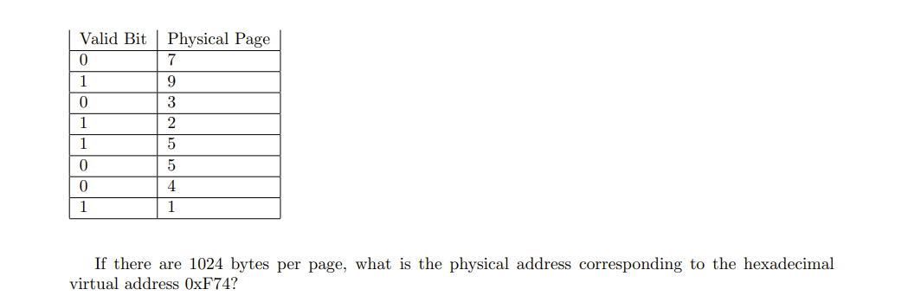
Question 3:

Slide 48
Question 4
If the physical memory size (in bytes) is doubled, how does the number of bits in each entry of the page table change?

Slide 49
Question 5
If the virtual memory size (in bytes) is doubled, how does the number of bits in each entry of the page table change?

Slide 50
Question 6
If the page size (in bytes) is doubled, how does the number of entries in the page map change?

Slide 51
Question 7
Suppose that you have a system with 8-bit virtual memory addresses, 8 pages of virtual memory, and 4 pages of physical memory. How large is each page? Assume memory is byte addressed.

